Slide 1
Blacktown Chinese Christian Church
Welcome to Our English Service 12.01.2025
English Service 9:45 – 11:00 am
Worship Songs: Passage: Speaker: Topic: Response Song: Announcements and Closing Prayer Benediction
Living Hope Lighthouse Shoulders T TBA TBA TBA

Slide 2
BCCC english service

Slide 3

Please keep all phones on silent

Slide 4
Living Hope
Brian Johnson, Phil Wickham © 2017 Phil Wickham Music (Admin. by Crossroad Distributors Pty. Ltd.) Simply Global Songs (Admin. by Crossroad Distributors Pty. Ltd.) Sing My Songs (Admin. by Crossroad Distributors Pty. Ltd.) Bethel Music Publishing (Admin. by SHOUT! Music Publishing Australia) CCLI Licence No. 5485849. CCLI Song number: 7106807

Slide 5
Verse 1
How great the chasm that lay between us
How high the mountain I could not climb
In desperation, I turned to heaven
And spoke Your name into the night

Slide 6
Verse 1
Then through the darkness, Your loving kindness
Tore through the shadows of my soul
The work is ﬁnished, the end is written
Jesus Christ, my living hope

Slide 7
Verse 2
Who could imagine so great a mercy?
What heart could fathom such boundless grace?
The God of ages stepped down from glory
To wear my sin and bear my shame

Slide 8
Verse 2
The cross has spoken, I am forgiven
The King of Kings calls me His own
Beautiful Savior, I'm Yours forever
Jesus Christ, my living hope

Slide 9
Chorus
Hallelujah, praise the One who set me free
Hallelujah, death has lost its grip on me

Slide 10
Chorus
You have broken every chain
There's salvation in Your name
Jesus Christ, my living hope

Slide 11
Chorus
Hallelujah, praise the One who set me free
Hallelujah, death has lost its grip on me

Slide 12
Chorus
You have broken every chain
There's salvation in Your name
Jesus Christ, my living hope

Slide 13
Verse 3
Then came the morning that sealed the promise
Your buried body began to breathe
Out of the silence, the Roaring Lion
Declared the grave has no claim on me (x2)

Slide 14
Verse 3
Jesus, Yours is the victory

Slide 15
Chorus
Hallelujah, praise the One who set me free
Hallelujah, death has lost its grip on me

Slide 16
Chorus
You have broken every chain
There's salvation in Your name
Jesus Christ, my living hope

Slide 17
Outro
Hallelujah, praise the One who set me free
Hallelujah, death has lost its grip on me

Slide 18
Outro
You have broken every chain
There's salvation in Your name
Jesus Christ, my living hope

Slide 19
Tag
Jesus Christ, my living hope
Oh God, You are my living hope

Slide 20
My Lighthouse
Chris Llewellyn, Gareth Gilkeson © 2013 Thankyou Music (Admin. by SHOUT! Music Publishing Australia) CCLI Licence No. 5485849 . CCLI Song number: 7002032

Slide 21
Verse 1
In my wrestling and in my doubts
In my failures You won't walk out

Slide 22
Verse 1
Your great love will lead me through
You are the peace in my troubled sea
You are the peace in my troubled sea

Slide 23
Verse 2
In the silence, You won't let go
In my questions, Your truth will hold

Slide 24
Verse 2
Your great love will lead me through
You are the peace in my troubled sea
You are the peace in my troubled sea

Slide 25
Chorus
My lighthouse
My lighthouse
Shining in the darkness
I will follow You

Slide 26
Chorus
My lighthouse
My lighthouse
I will trust the promise
You will carry me safe to shore

Slide 27
Chorus
Safe to shore
Safe to shore
Safe to shore

Slide 28
Verse 3
I won't fear what tomorrow brings
With each morning I'll rise and sing

Slide 29
Verse 3
My God's love will lead me through
You are the peace in my troubled sea
You are the peace in my troubled sea

Slide 30
Chorus
My lighthouse
My lighthouse
Shining in the darkness
I will follow You

Slide 31
Chorus
My lighthouse
My lighthouse
I will trust the promise
You will carry me safe to shore

Slide 32
Chorus
Safe to shore
Safe to shore
Safe to shore

Slide 33
Bridge
Fire before us, You're the brightest
You will lead us through the storms (x4)

Slide 34
Chorus
My lighthouse
My lighthouse
Shining in the darkness
I will follow You

Slide 35
Chorus
My lighthouse
My lighthouse
I will trust the promise
You will carry me safe to shore

Slide 36
Chorus
Safe to shore
Safe to shore
Safe to shore

Slide 37
Shoulders
Ben Glover, Joel Smallbone, Luke Smallbone, Tedd T. © Curb Dayspring Music (Admin. by CopyCare Pacific Pty. Ltd.) CCLI Licence No. 5485849 . CCLI Song number: 7028523

Slide 38
Verse 1
When confusion's my companion
And despair holds me for ransom
I will feel no fear
I know that You are near

Slide 39
Verse 2
When I'm caught deep in the valley
With chaos for my company
I'll find my comfort here
‘Cause I know that You are near

Slide 40
Chorus
My help comes from You
You're right here, pulling me through

Slide 41
Chorus
You carry my weakness, my sickness,
My brokenness all on Your shoulders
Your shoulders

Slide 42
Chorus
My help comes from You
You are my rest, my rescue

Slide 43
Chorus
I don't have to see to believe that
You're lifting me up on Your shoulders
Your shoulders

Slide 44
Verse 3
You mend what once was shattered
And You turn my tears to laughter
Your forgiveness is my fortress
Oh Your mercy is relentless

Slide 45
Chorus
My help comes from You
You're right here, pulling me through

Slide 46
Chorus
You carry my weakness, my sickness,
My brokenness all on Your shoulders
Your shoulders

Slide 47
Chorus
My help comes from You
You are my rest, my rescue

Slide 48
Chorus
I don't have to see to believe that
You're lifting me up on Your shoulders
Your shoulders

Slide 49
Bridge
My help is from You
(Don't have to see it to believe it)

Slide 50
Bridge
My help is from you
(Don't have to see it, cause I know,
cause I know it's true)

Slide 51
Bridge
My help is from You
(Don't have to see it to believe it)

Slide 52
Bridge
My help is from you
(Don't have to see it, cause I know,
cause I know it's true)

Slide 53
Chorus
My help comes from You
You're right here, pulling me through

Slide 54
Chorus
You carry my weakness, my sickness,
My brokenness all on Your shoulders
Your shoulders

Slide 55
Chorus
My help comes from You
You are my rest, my rescue

Slide 56
Chorus
I don't have to see to believe that
You're lifting me up on Your shoulders
Your shoulders

Slide 57
Bridge
My help is from You
(Don't have to see it to believe it)

Slide 58
Bridge
My help is from you
(Don't have to see it, cause I know,
cause I know it's true)

Slide 59
Bridge
My help is from You
(Don't have to see it to believe it)

Slide 60
Bridge
My help is from you
(Don't have to see it, cause I know,
cause I know it's true)

Slide 61
Bridge
My help is from You
(Don't have to see it to believe it)

Slide 62
Bridge
My help is from you
(Don't have to see it, cause I know,
cause I know it's true)

Slide 63
Bridge
My help is from You
(Don't have to see it to believe it)

Slide 64
Bridge
My help is from you
(Don't have to see it, cause I know,
cause I know it's true)

Slide 65

Bible reading

Slide 66
Bible reading: T
T

Slide 67
Announcements

Slide 68





Account name: Blacktown Chinese Christian Church
Account number: 4216 50263
Offering
BSB: 112 - 879
Please put in "offering" as the reference
The offering box is available at the back of the hall

Slide 69
Prayer points

Slide 70
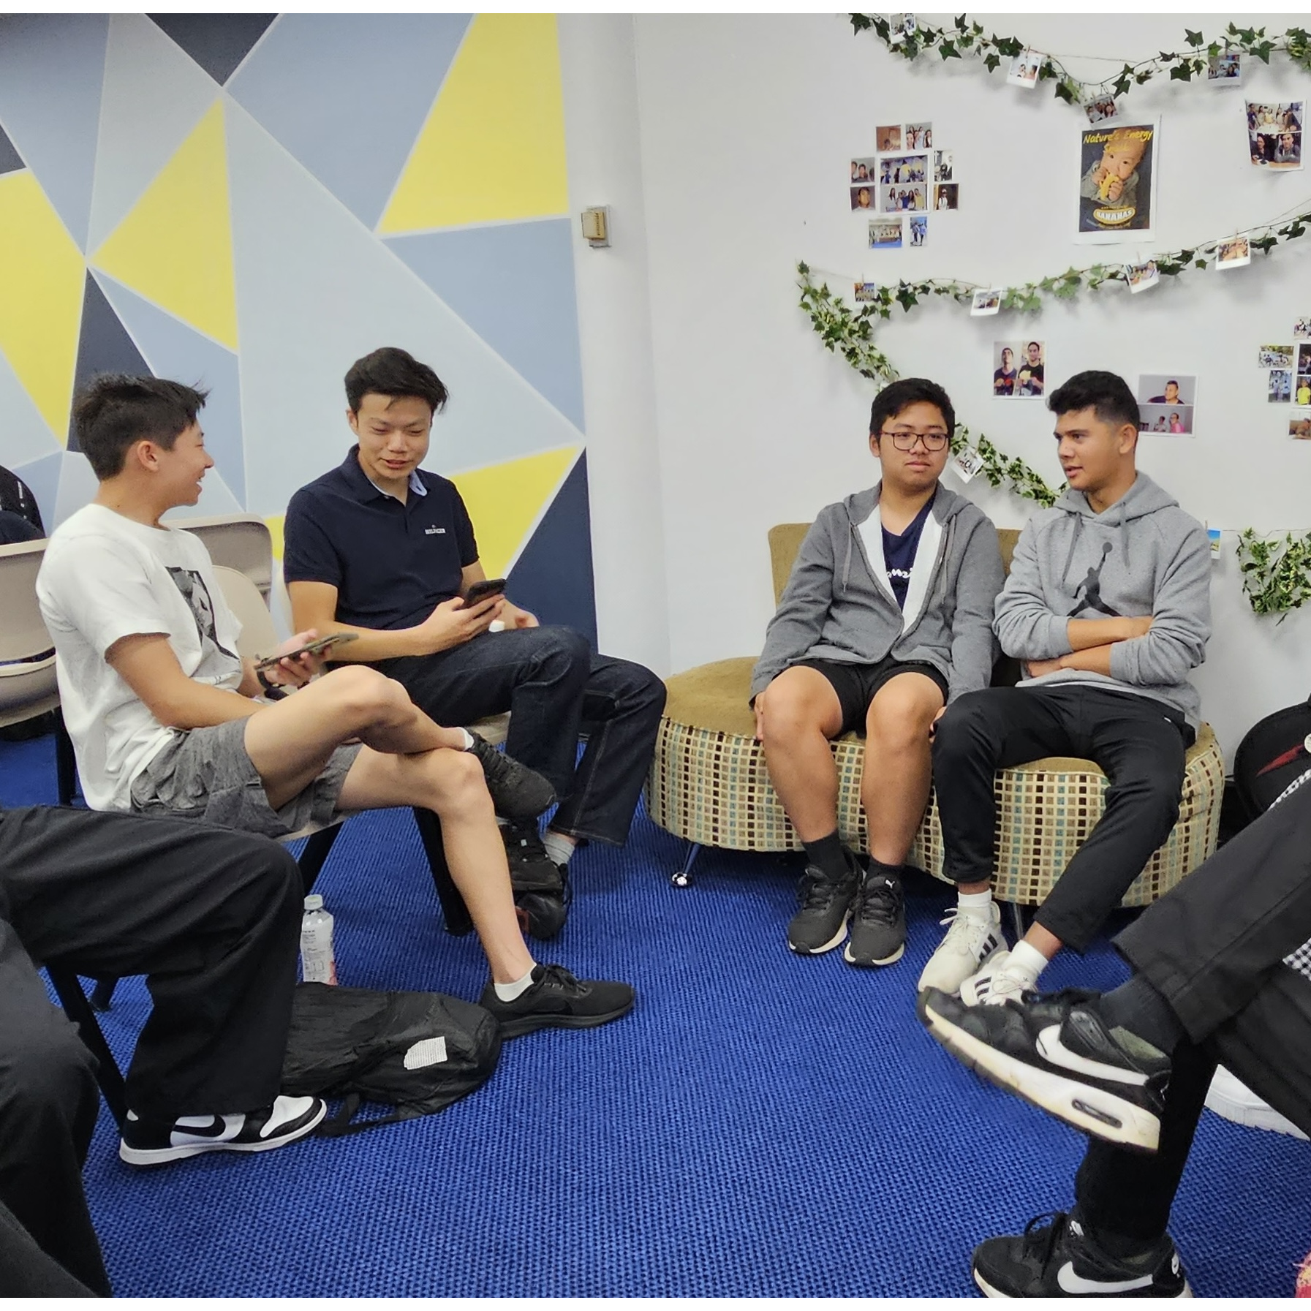
Mingle time!

